Slide 1
Architectural Optimization and Comparative Benchmarking of Attention-Augmented YOLO Models for Deep-Sea Litter Classification
19CSE437 – Deep Learning for Computer Vision
Team Number : 3
S.No | Reg.No | Name of the Student | Section
1 | BL.EN.U4CSE22173 | A Tharun | CSE B
2 | BL.EN.U4CSE22170 | M Sai Govardhan | CSE B
3 | BL.EN.U4CSE22044 | P Jayachetan | CSE A
Notes:
Good morning ma’am, Today, I’ll be presenting our project titled: “Architectural Optimization and Comparative Benchmarking of Attention-Augmented YOLO Models for Deep-Sea Litter Classification.”This work focuses on improving the performance of YOLO models by integrating attention mechanisms, specifically for the challenging task of classifying underwater waste into four simplified categories — cloth, metal, glass, and plastic.

Slide 2
Problem Definition
Existing object detection models like YOLO struggle with detecting small or overlapping objects accurately.
Standard YOLO models may miss important details due to lack of attention to key image regions.
There is a need to improve YOLO’s accuracy using techniques like attention modules and better backbone networks
.
Notes:
Existing object detection models like YOLO face challenges in accurately detecting small or overlapping objects, often leading to missed detections. One major limitation is that standard YOLO architectures do not effectively focus on the most important regions within an image, causing them to overlook subtle but crucial features. This lack of attention reduces the overall detection accuracy, especially in complex scenes. To address these shortcomings, it is essential to enhance YOLO’s performance using advanced techniques such as attention modules (e.g., CBAM) that help the model prioritize relevant spatial and channel information. Additionally, incorporating improved backbone networks can strengthen feature extraction, ultimately leading to better object detection results.

Slide 3
Introduction
Object detection is a key task in computer vision that involves identifying and classifying objects within images.
YOLO (You Only Look Once) is a real-time object detection algorithm known for its speed and efficiency.
Despite its performance, YOLO can struggle with detecting small or overlapping objects.
Enhancements like attention modules and advanced backbone networks are used to improve YOLO’s detection accuracy.
Notes:
Object detection is a fundamental task in computer vision that focuses on identifying and classifying objects within images. YOLO (You Only Look Once) is a popular real-time object detection algorithm praised for its high speed and efficiency. However, despite its strong overall performance, YOLO can face challenges in accurately detecting small or overlapping objects. To overcome these limitations, researchers enhance YOLO’s accuracy by integrating attention modules and employing more advanced backbone networks, which help the model better focus on important features and improve detection quality.

Slide 4
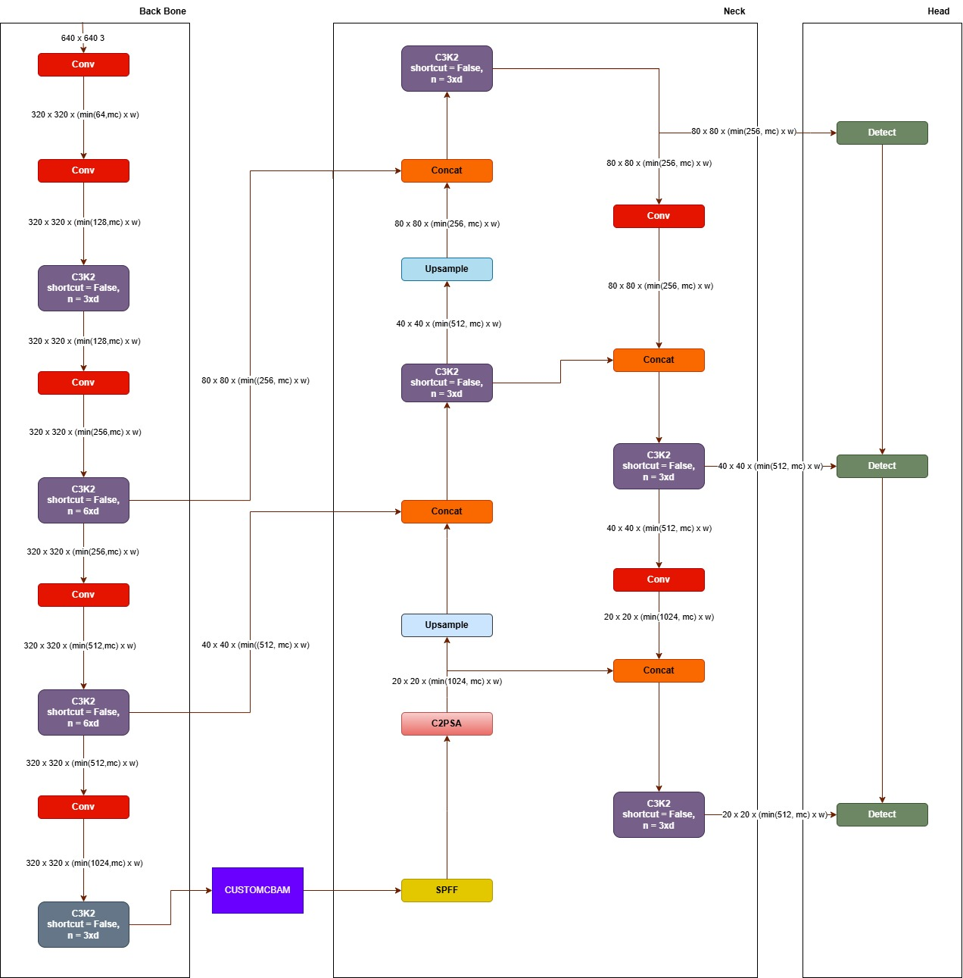
System Architecture:Attention at Layer 10

Slide 5
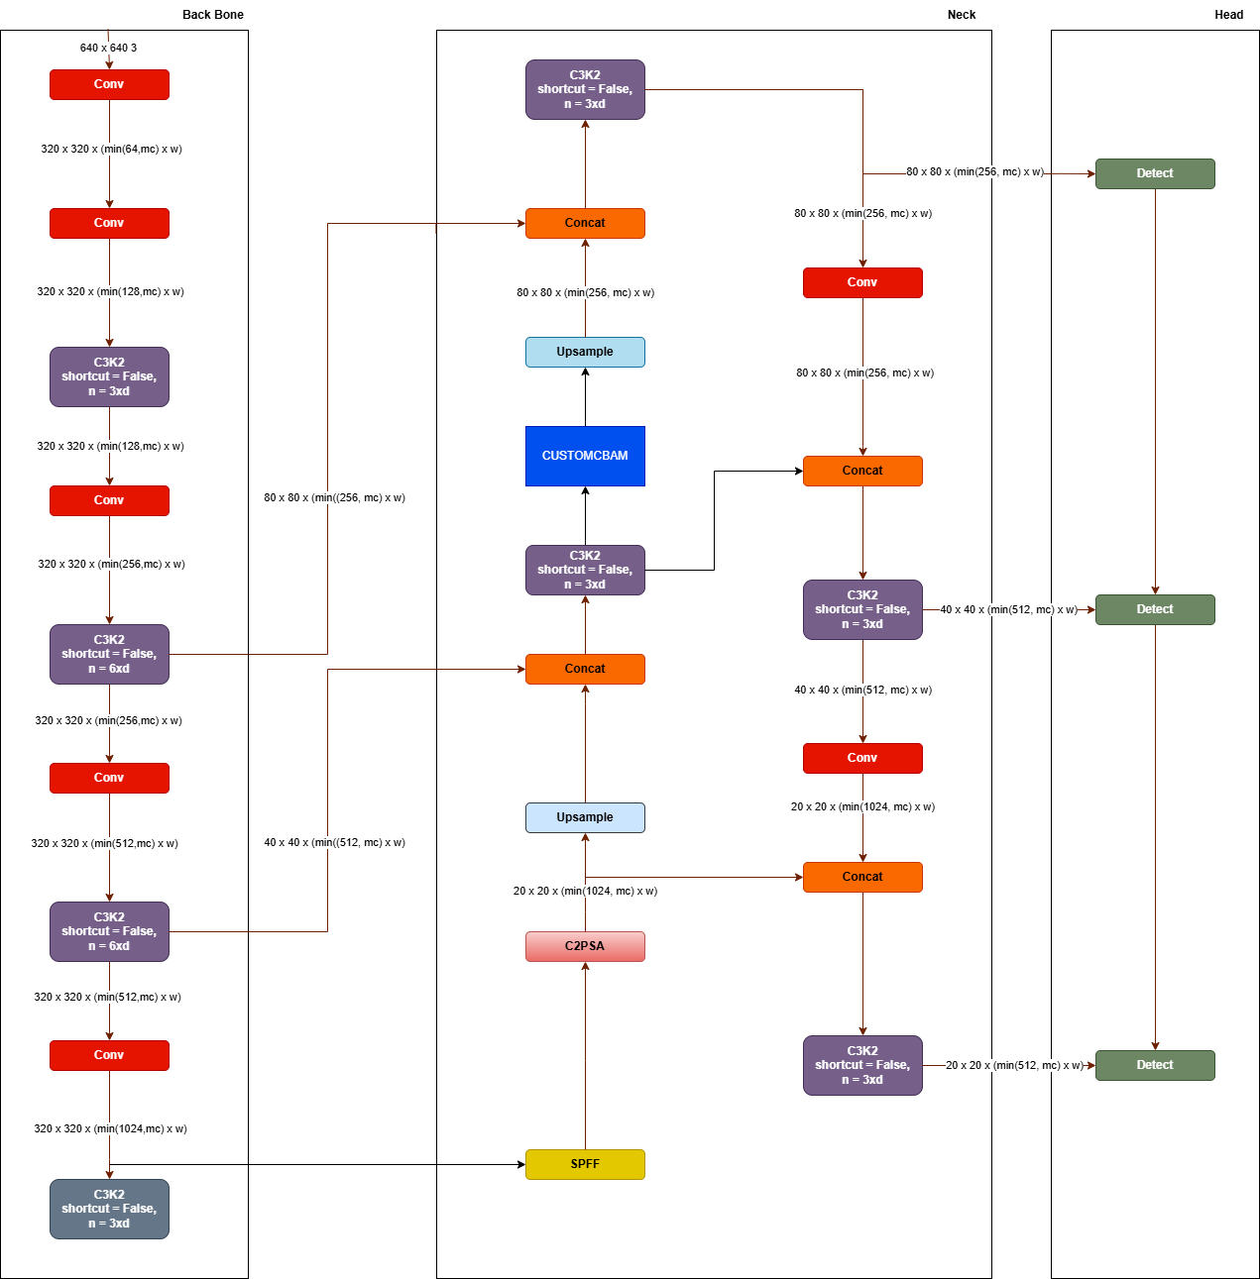
System Architecture:Attention at Layer 14

Slide 6
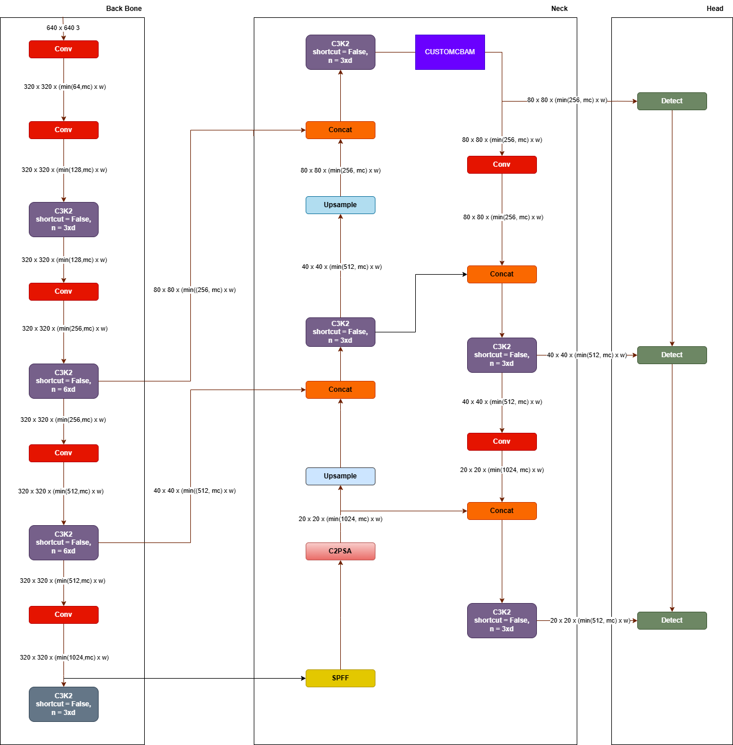
System Architecture:Attention at Layer 17

Slide 7
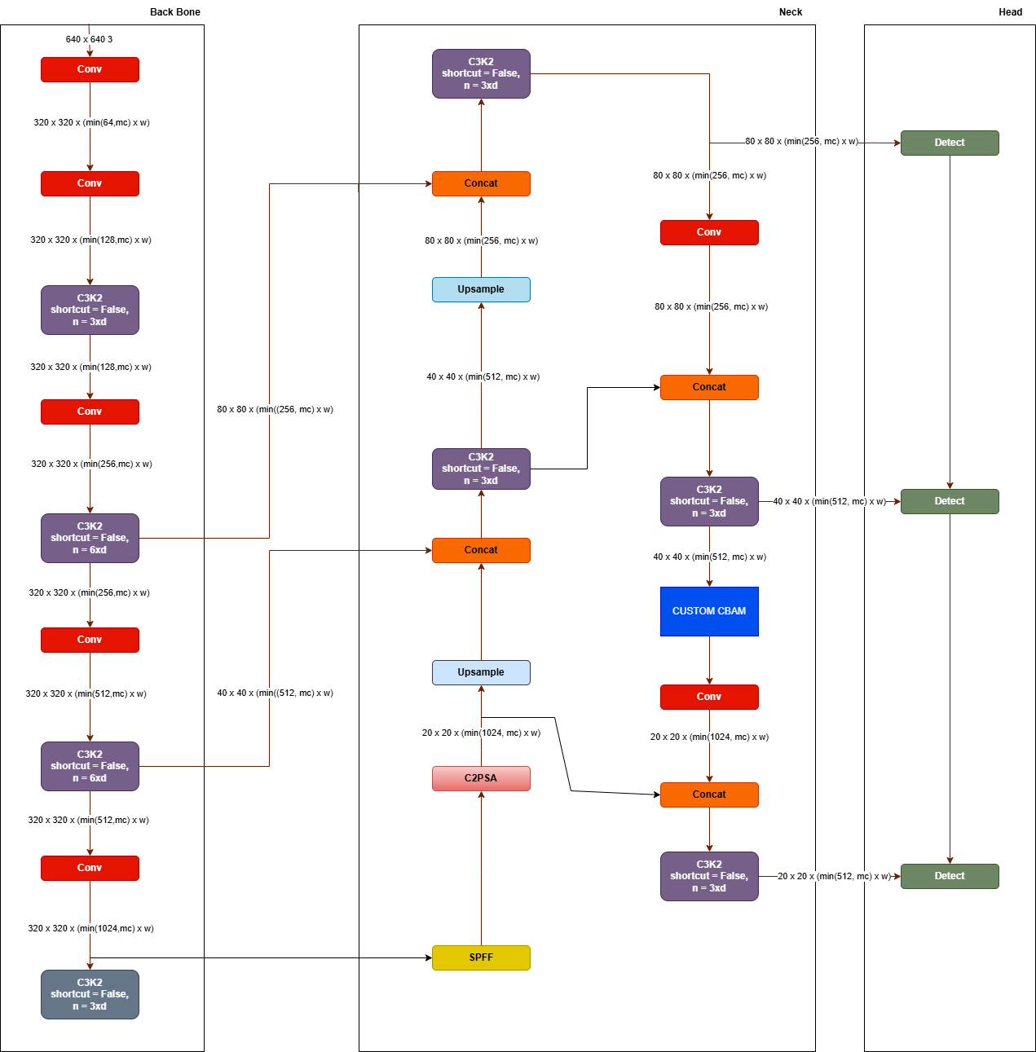
System Architecture:Attention at Layer 20

Slide 8
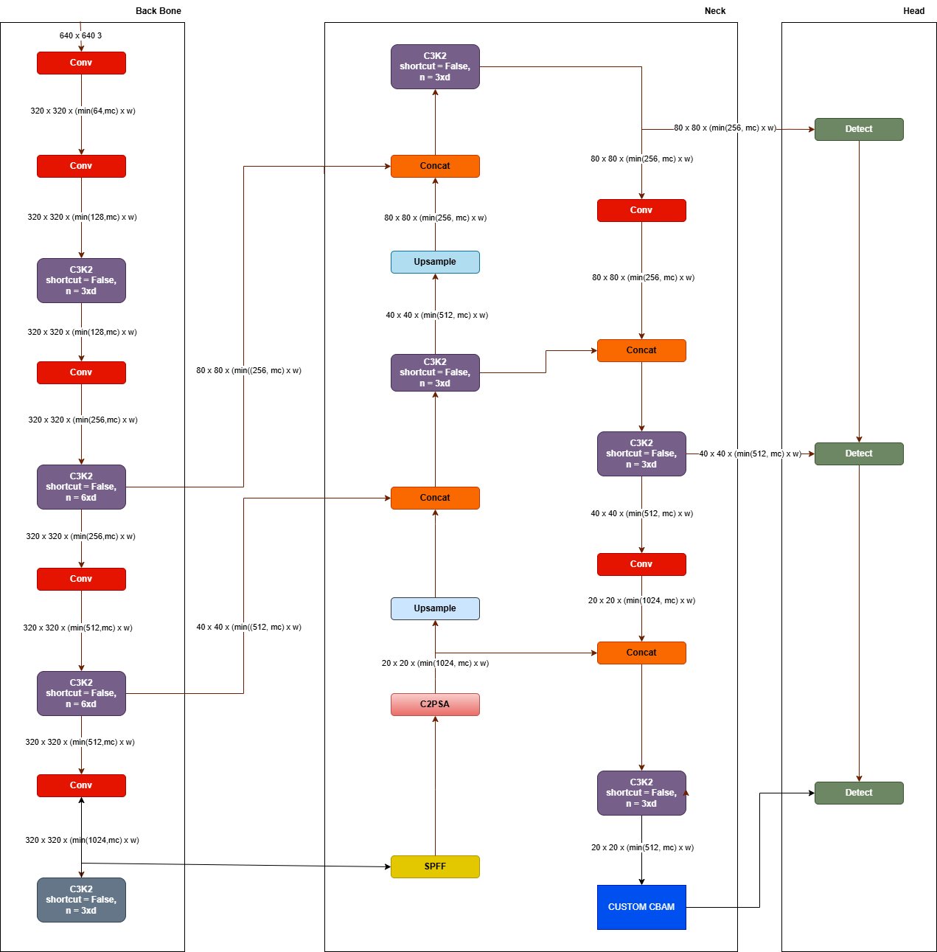
System Architecture:Attention at Layer 23

Slide 9
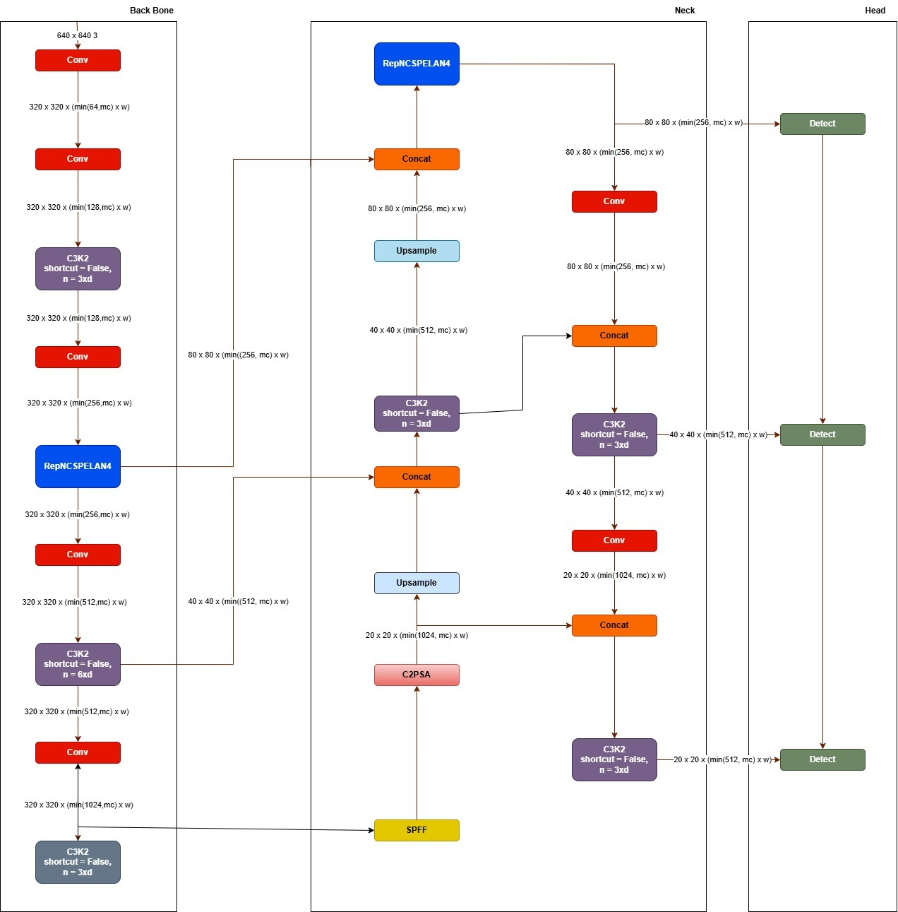
System Architecture:Yolo11 with RepNCSPNLAN4

Slide 10
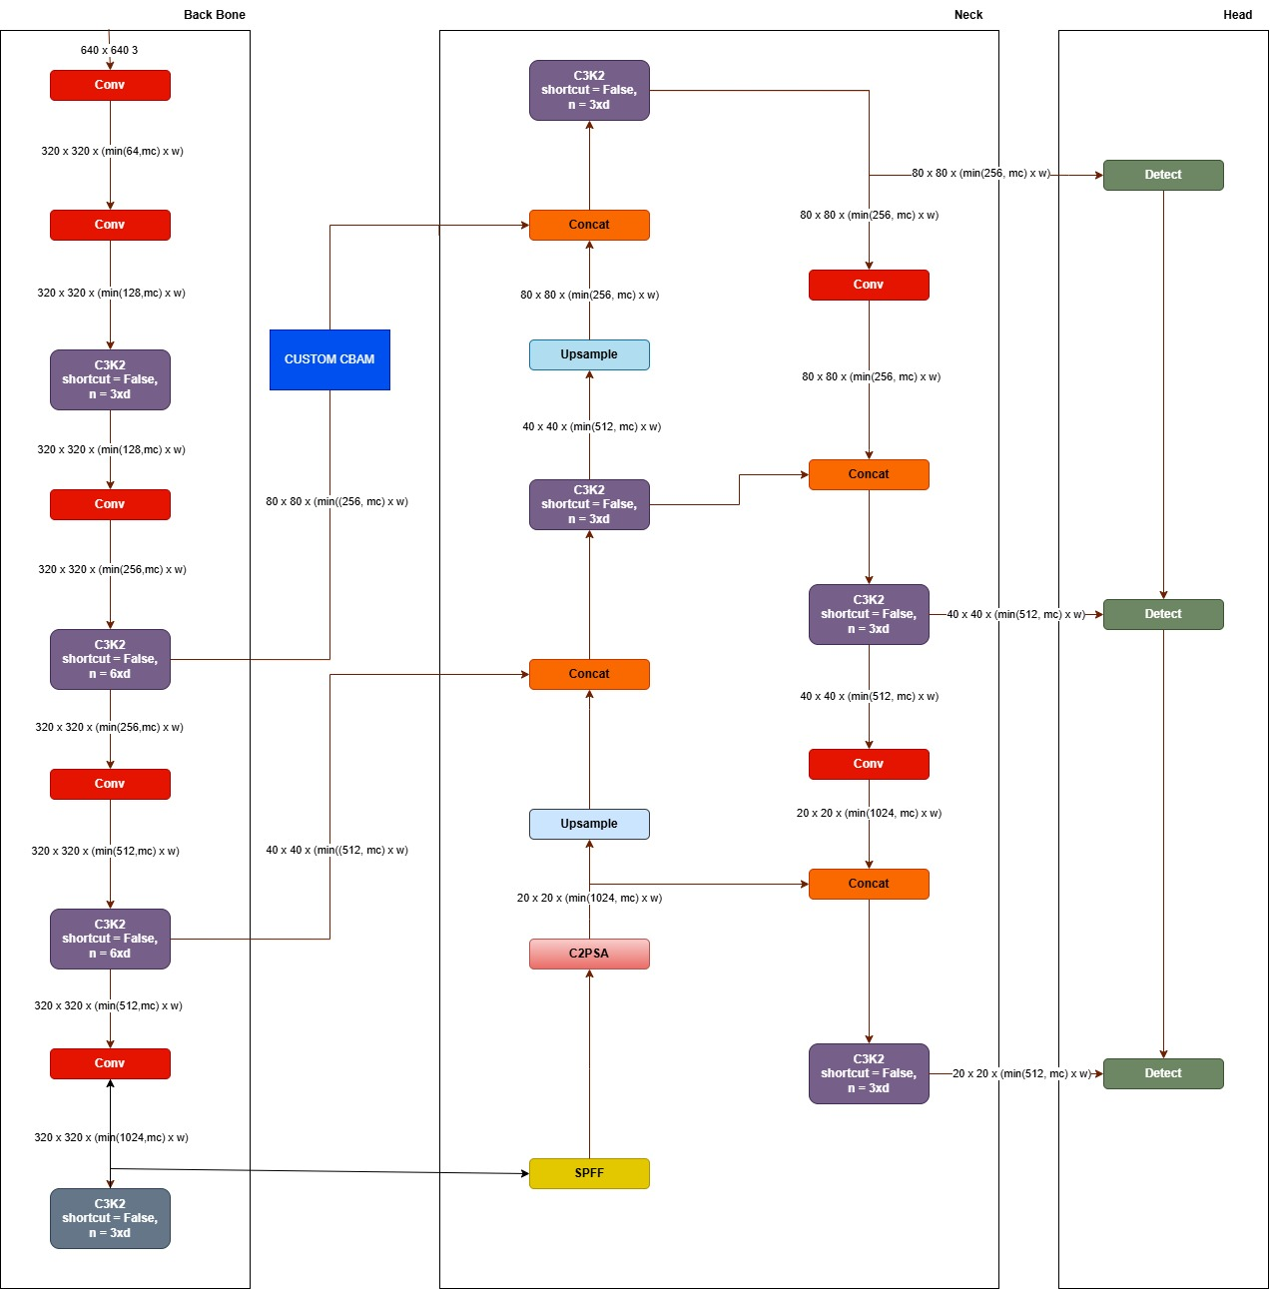
System Architecture:Attention at skip Connection

Slide 11
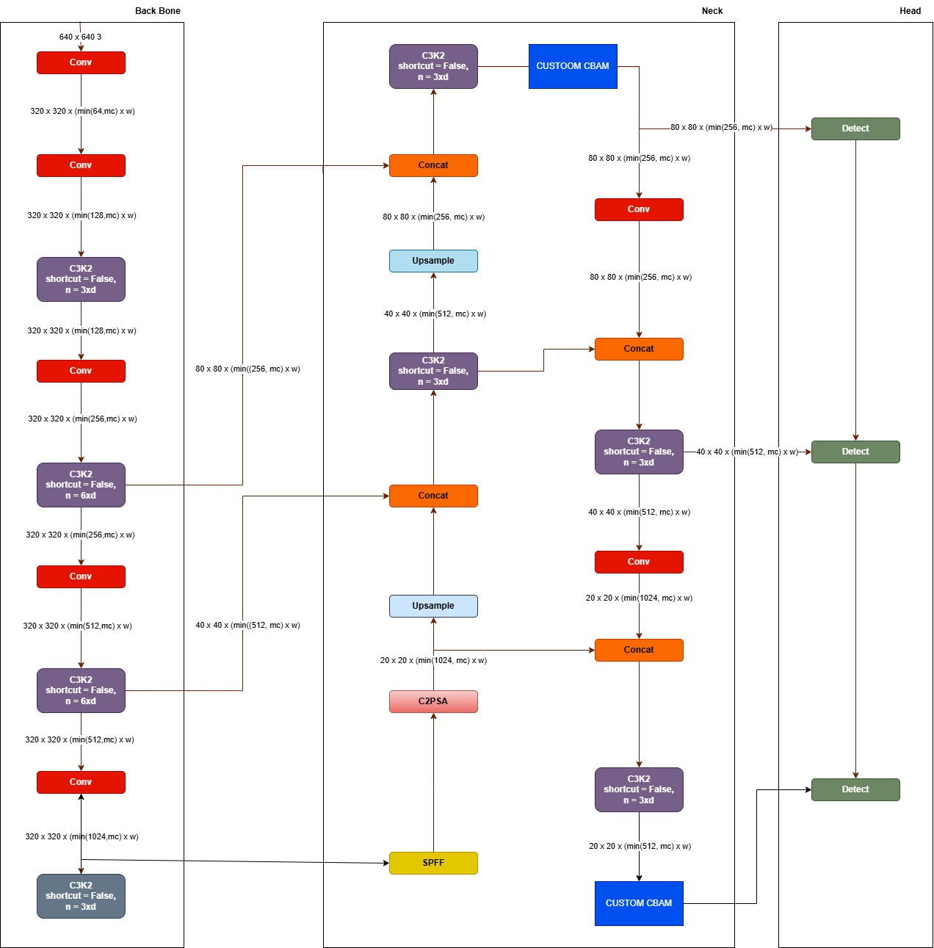
System Architecture:Attention at Layer 17 and 24

Slide 12
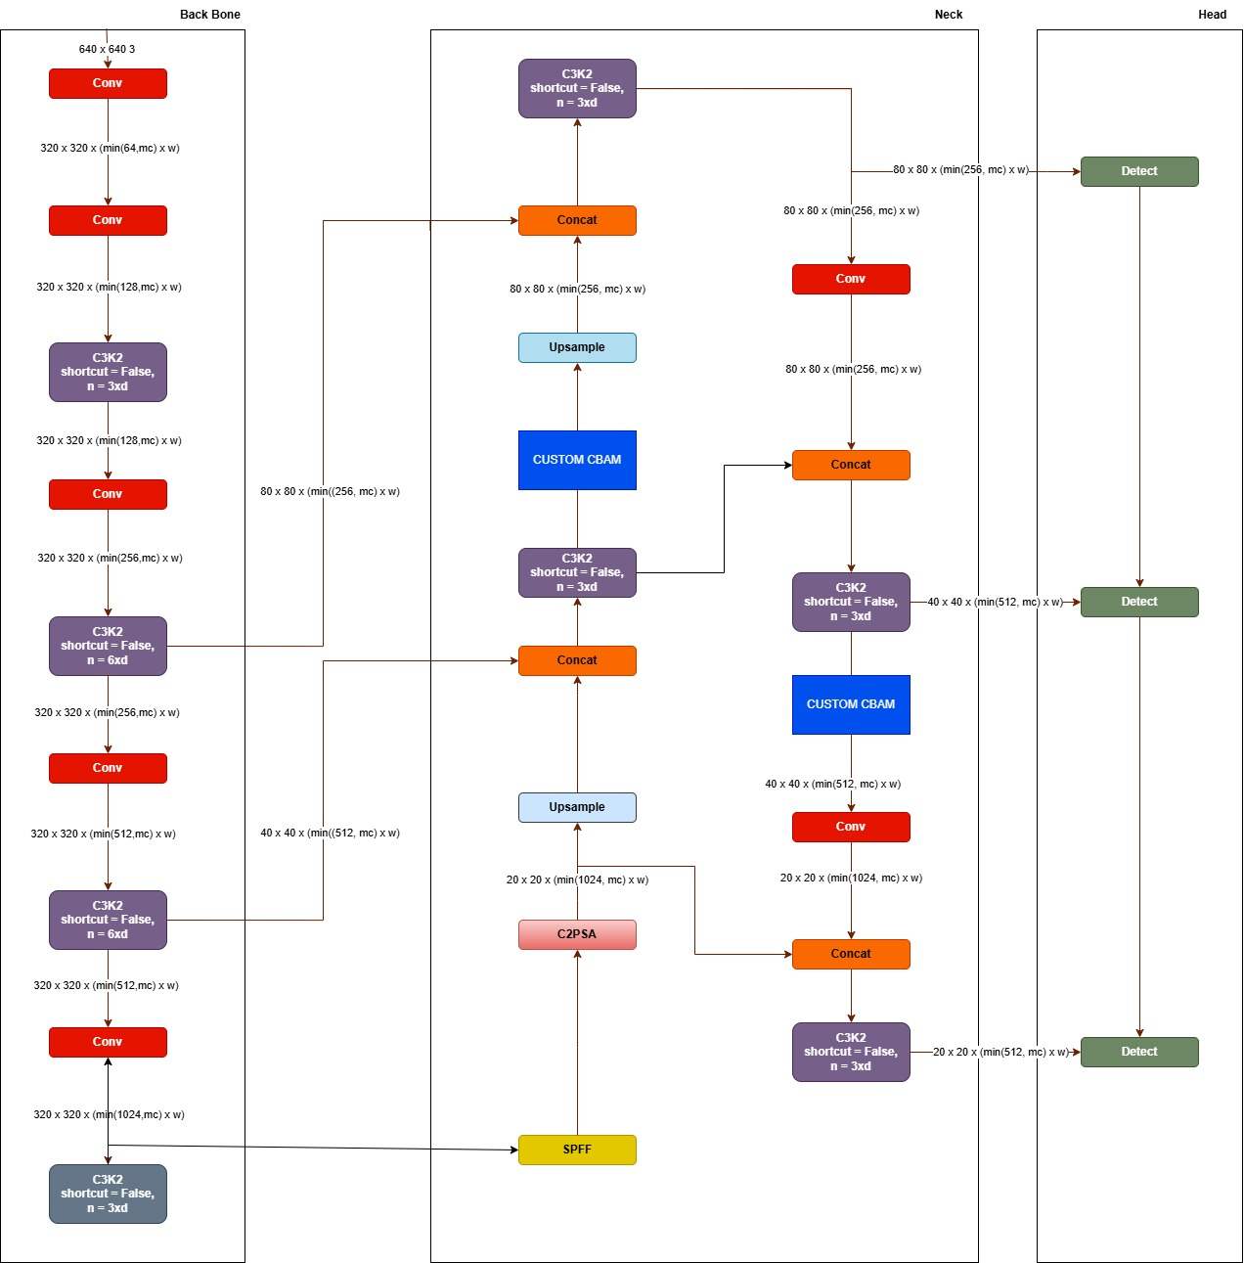
System Architecture:Attention at Layer 14 and 21

Slide 13
Methodology
1.Dataset Annotation
Manual annotation performed using Roboflow to create bounding boxes around objects of interest.
Annotations converted into YOLO-compatible format for training.
2. Data Preprocessing
Images resized to standard dimensions (416×416 and 640×640 pixels) to maintain consistency.
Normalization applied to enhance model training efficiency and accuracy.
Dataset Split:
Train 2500 images
Test 266 images
Valid 266 images

Slide 14
Methodology
3.Model Development with Novelty
Utilized multiple YOLO-based models including:
YOLO integrated with ResNet50 backbone to improve feature extraction.
YOLO models enhanced with attention layers inserted at various depths (layers 10, 14, 17, 20, 23) to focus on relevant features.
Standard YOLO versions (v5, v9, v10, v11, v12) for baseline comparison.
4. Object Detection & Performance Evaluation
Predicted objects using bounding boxes and classes.
Evaluation metrics such as Precision, Recall, and mean Average Precision at IoU 0.5 (mAP@0.5) were used to quantify performance and effectiveness.

Slide 15
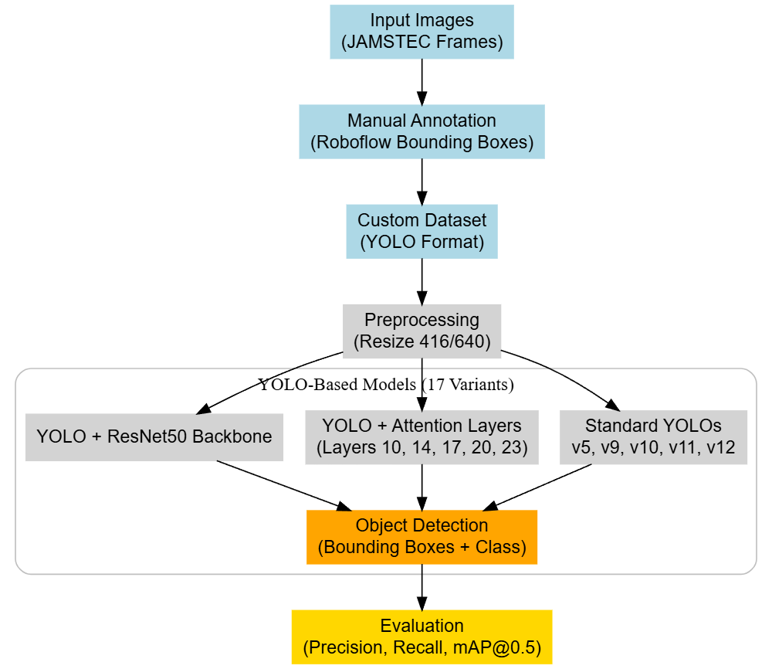
Proposed Method diagram
-

Slide 16
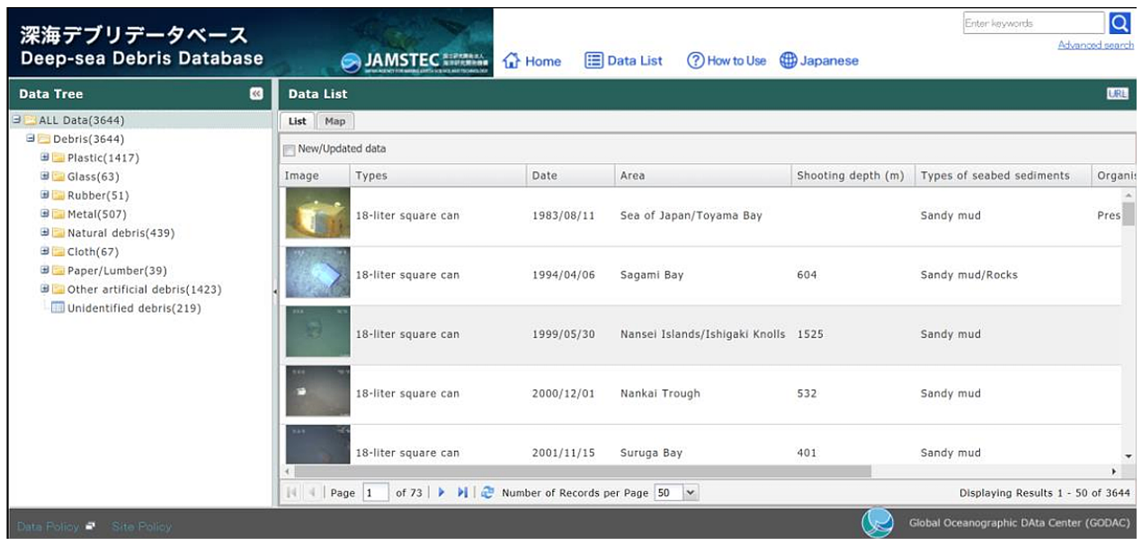
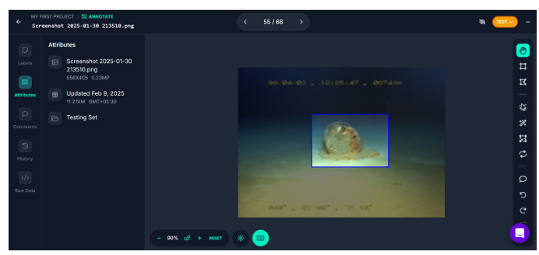
Dataset Details
Images sourced from JAMSTEC underwater exploration frames.
Dataset manually annotated using Roboflow with bounding boxes for object localization.
Annotations formatted in YOLO style for seamless model training.
Dataset includes diverse marine species and underwater objects to ensure robust detection.

Slide 17
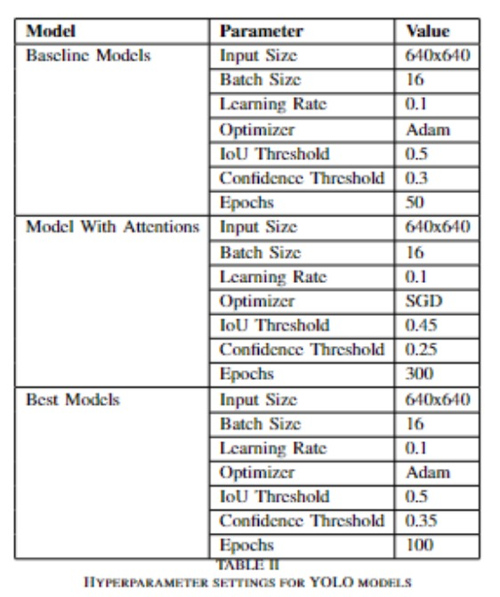
Parameters Used

Slide 18
Evaluation Metrics Used
Precision: Measures the accuracy of positive predictions, i.e., the proportion of correctly identified objects among all detected objects.
Recall: Measures the ability of the model to find all relevant objects, i.e., the proportion of true objects detected.
mAP@0.5: Mean Average Precision at an Intersection over Union (IoU) threshold of 0.5, evaluates detection quality with moderate overlap requirement.
mAP@0.5:0.95: Mean Average Precision averaged over multiple IoU thresholds from 0.5 to 0.95 in steps of 0.05, providing a comprehensive measure of model accuracy considering varying degrees of bounding box overlap.

Slide 19
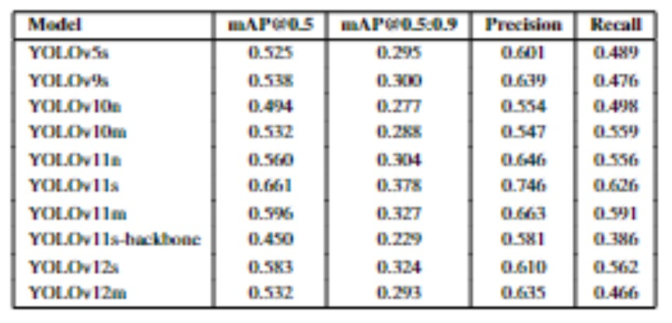
Results

Slide 20
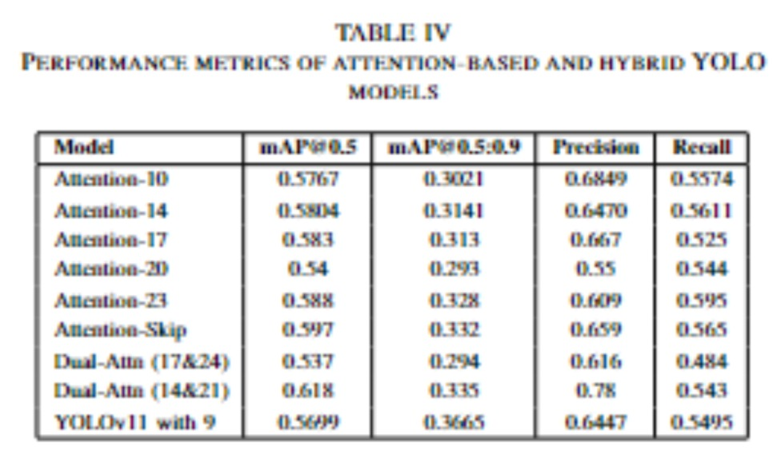
Results

Slide 21
Comparative Analysis: Baseline vs Attention Models
Baseline YOLO models, especially YOLOv11s, showed strong performance with high mAP, precision, and recall.
Attention-augmented models (using CBAM) did not consistently improve performance over the baselines.
Early layer attention (Attention-10) improved recall but lowered overall mAP.
Mid-to-deep attention variants (Attention-14 & 17) showed mixed results, sometimes increasing precision but not surpassing baselines.

Slide 22
Comparative Analysis: Baseline vs Attention Models
Dual-attention models (Attention-14 & 21) had slight gains but didn’t outperform the best baseline model.
Skip-connection attention provided modest improvements but was not enough to beat baseline metrics.
Overall, baseline models delivered better or comparable detection results than attention-augmented versions in this study.

Slide 23
Why Attention is Used in the Neck Layer
Multi-scale Feature Emphasis: Attention mechanisms help focus on important features at different scales, improving the detection of objects of varying sizes.
Enhanced Feature Fusion: Attention improves the fusion of features from different layers, making the combined features more context-aware and informative.
Noise Reduction: It filters out irrelevant or redundant information, allowing the model to concentrate on meaningful object features and suppress background noise.

Slide 24
Why Two Attentions are used
Enhanced Feature Extraction: Combining attentions helps capture a wider range of important features from the image.
Improved Focus: Different attention types complement each other to better highlight relevant details.
Robustness: Helps the model handle complex backgrounds and overlapping objects more effectively.

Slide 25
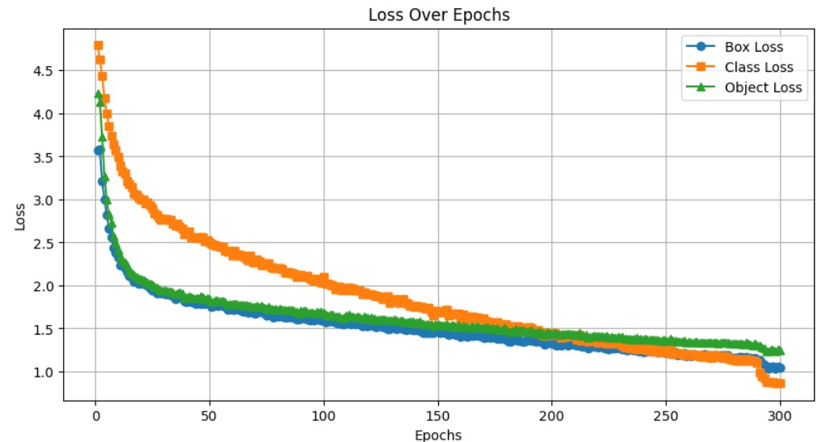
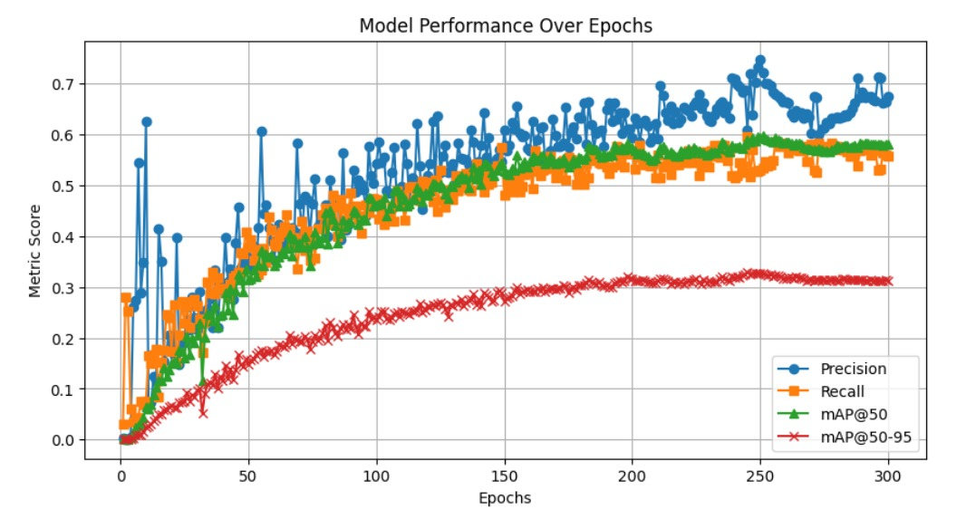
Results and Analysis
Attention at Layer 23
Notes:
The training loss steadily decreases over the 300 epochs, showing that the model continues to learn and minimize errors.
After a certain point, the loss curve begins to flatten, indicating the model is reaching convergence.
No major spikes in the curve suggest stable training without overfitting or instability.

Slide 26
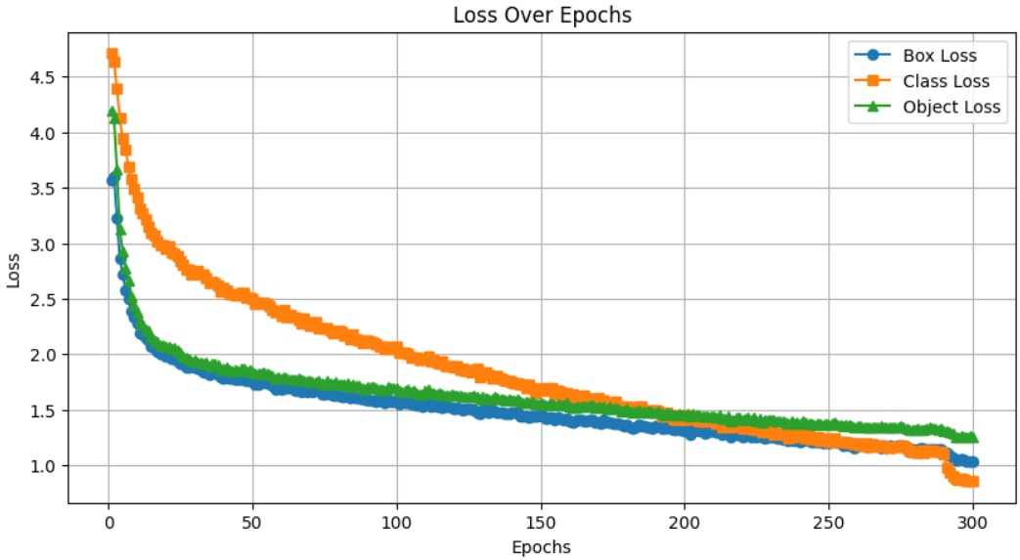
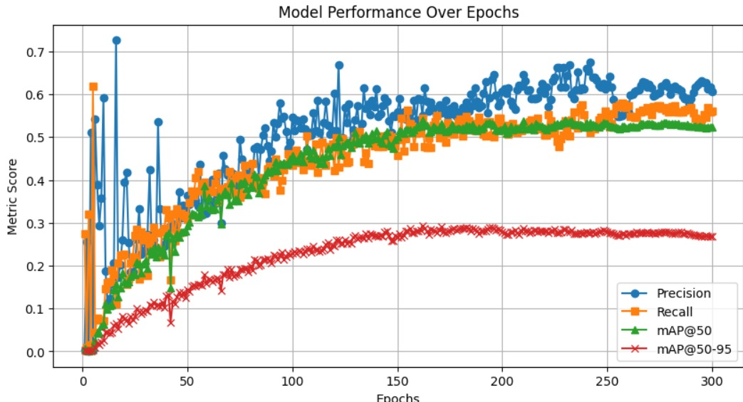
Results and Analysis
Attention at Layer 20

Slide 27
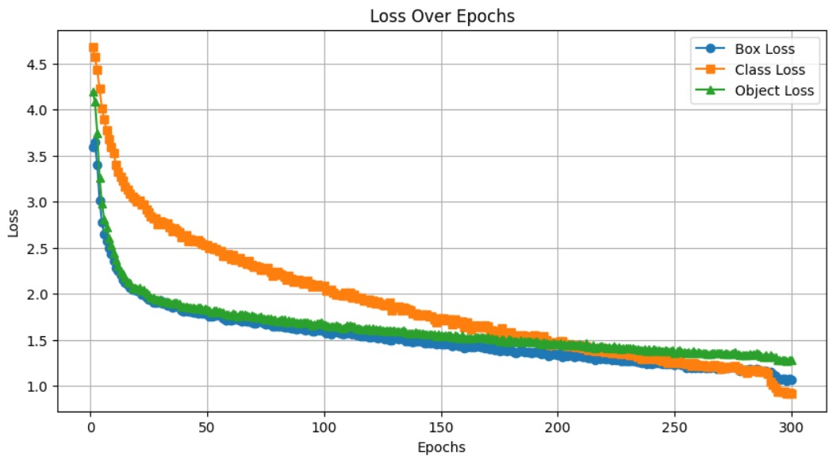
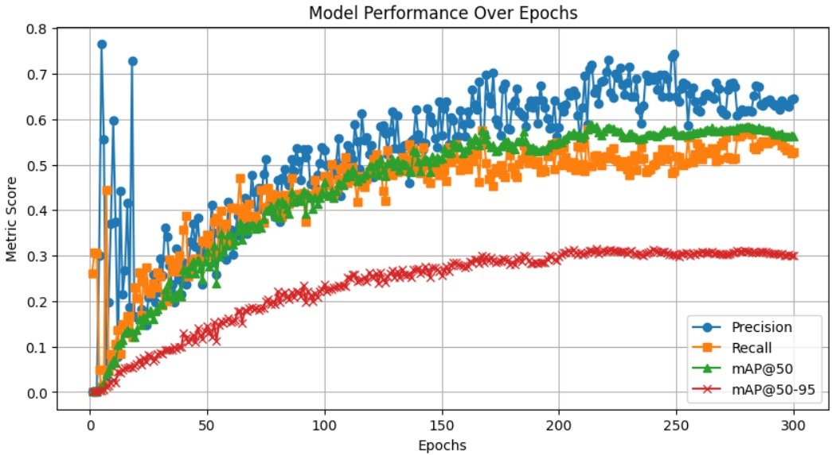
Results and Analysis
Attention at Layer 17

Slide 28
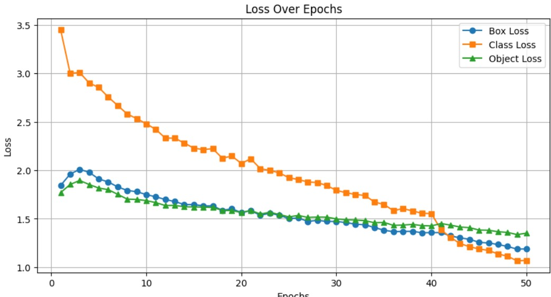
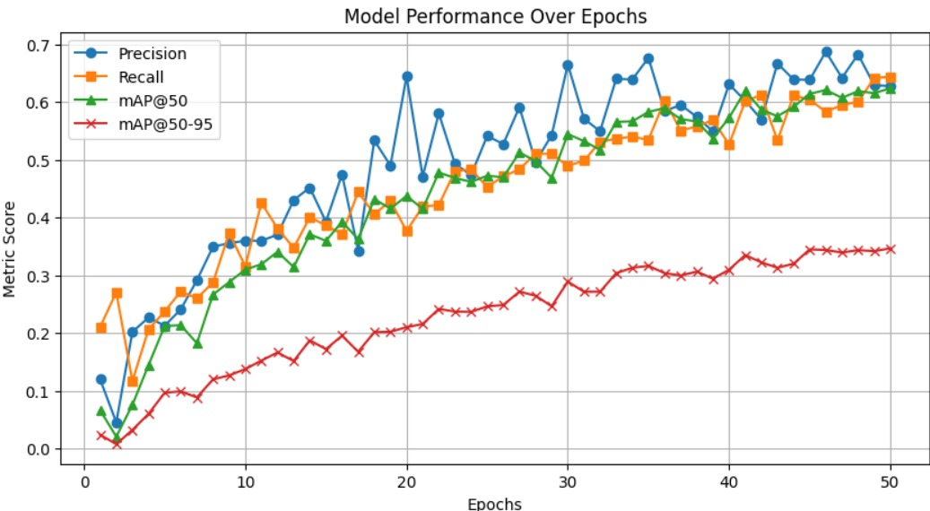
Results and Analysis
Yolov11s

Slide 29
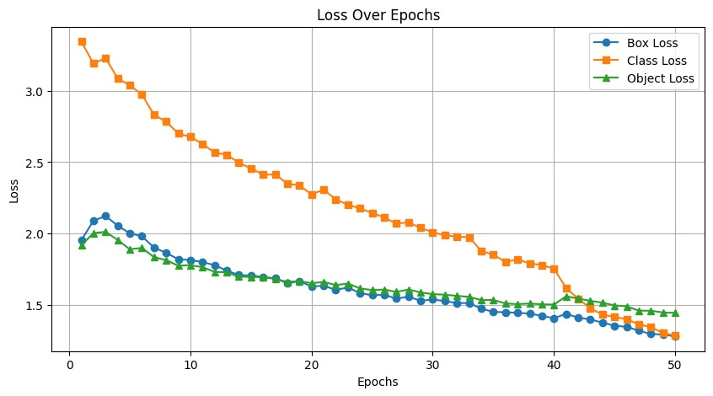
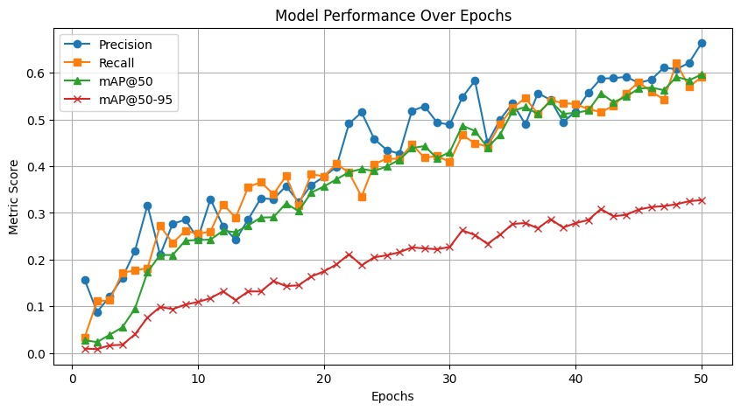
Results and Analysis
Yolo11m

Slide 30
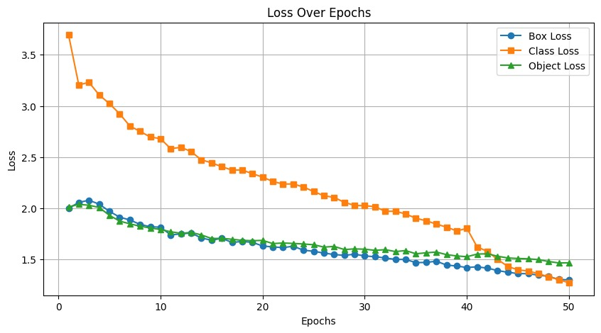
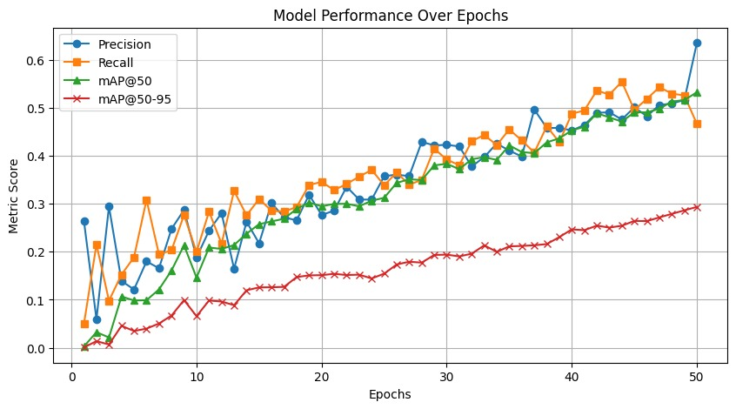
Results and Analysis
Yolo12s

Slide 31
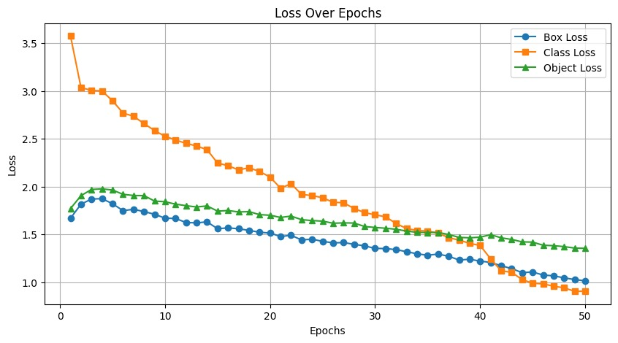
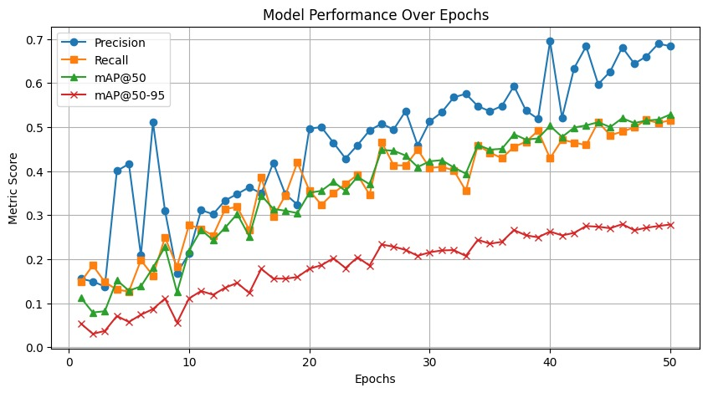
Results and Analysis
Yolo5s

Slide 32
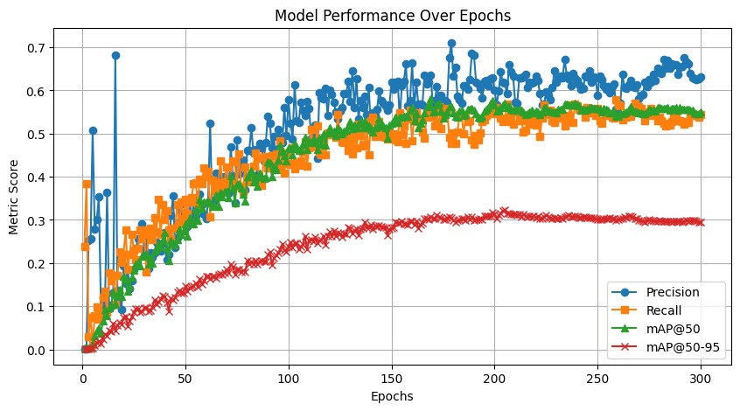
Results and Analysis
Attention at layer 14 and 21

Slide 33
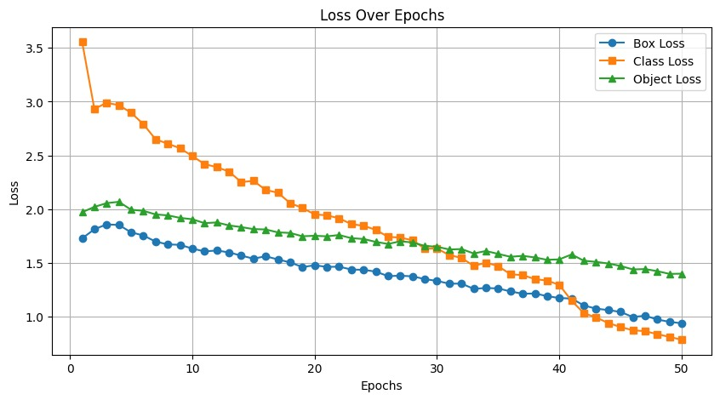
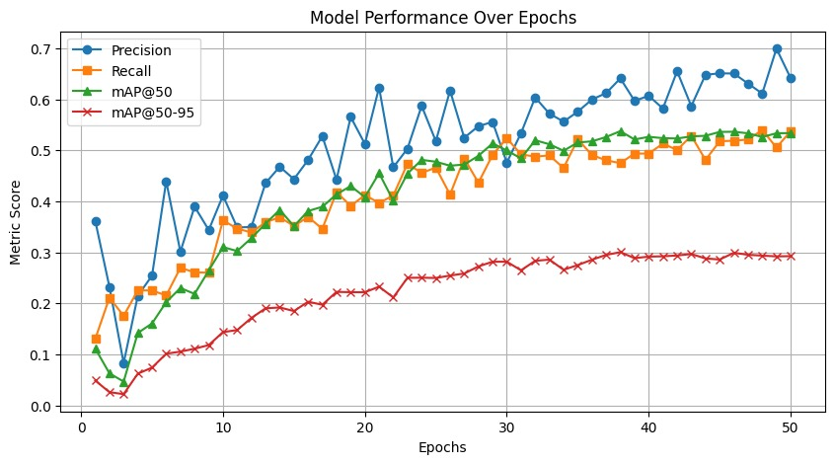
Results and Analysis
Yolo9s

Slide 34
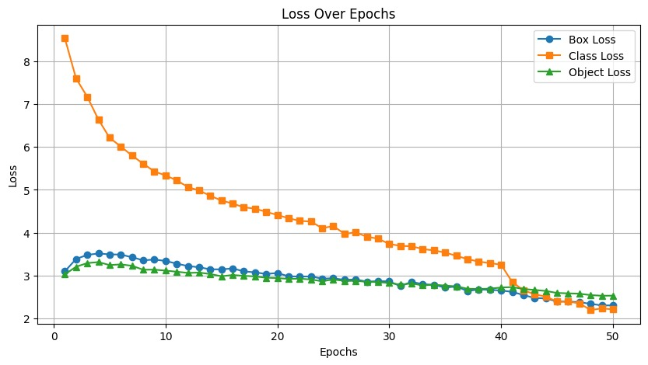
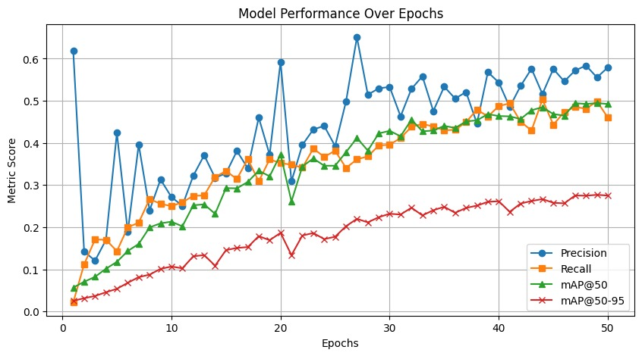
Results and Analysis
Yolo10n

Slide 35
Conclusion
Among all tested YOLO variants, YOLOv11s achieved the highest mAP@0.5–0.95, indicating superior object detection performance.
Among all tested YOLO variants, YOLOv11s achieved the highest mAP@0.5–0.95, indicating superior object detection performance.
Its lightweight architecture combined with effective feature extraction made it ideal for fast and accurate underwater detection.
YOLOv11s outperformed larger models due to its efficient use of attention and backbone optimization, making it suitable for real-time applications.
This result confirms that smaller, well-tuned models like YOLOv11s can outperform heavier ones when adapted correctly for the domain.

Slide 36
Contribution
S.no | Name | Contribution
1 | A Tharun | YOLO11 with attention 23,Attention-Skip,Dual-YOLO11 with Attn (17&24),Dual-Attn (14&21),YOLOv11 with 9, YOLOv11s YOLOv11m,YOLOv11s-backbone
2 | M Sai Govardhan | YOLOv11n, YOLOv12s,YOLOv12m Attention-10,Attention-14
3 | P Jayachetan | YOLOv5s, YOLOv9s, YOLOv10n, YOLO11 with attention 17,YOLOv10m,YOLO11 with attention 17

Slide 37
THANK YOU

